Slide 1
Inference
Bayesian

Slide 2
This would be statistics
f(x|params)
Parameters
x₁,x₂,x₃,...

Slide 3
Inference
f(x|params)
P(params)
Parameters
x₁,x₂,x₃,...
f(x|params)
P(params|data)
Parameters
Notes:
To do inference, we assume there is a generative model

Slide 4
Inference
f(x|params)
P(params)
Prior
Parameters
x₁,x₂,x₃,...
f(x₁,x₂,x₃,...|params)
P(params|data)
Posterior
Likelihood
Parameters
Notes:
To do inference, we assume there is a generative model

Slide 5
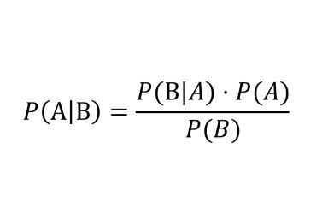
Bayes' theorem

Slide 6
Bayes' theorem
Likelihood
Prior
Posterior

Slide 7
Bayes' theorem
Likelihood
Prior
Posterior
By Total Probability
P(B) = P(B|A1)P(A1) + P(B|A2)P(A2) + … + P(B|An)P(An)

Slide 8
Bayes' theorem
Likelihood
Prior
Posterior
By Total Probability
P(B) = P(B|A1)P(A1) + P(B|A2)P(A2) + … + P(B|An)P(An)
P(B) = ∫P(B|A)dA

Slide 9
Inference on the urn

Slide 10
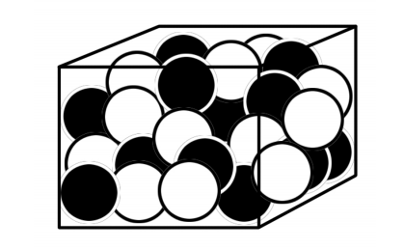
What is the winning strategy?
Imagine you are in a contest, you are given the urn with balls (white and black) and we have 100 turns.
Each turn consists of the following:
We say which color we think the next ball will be
We draw a ball from the urn and record the color, comparing with our "prediction"
Put the ball back in the urn
The urn is shuffled
The prize equals the number of correct guesses.

Slide 11

Decisions...decisions
To play the game, we have to decide which color to say next
Simplifying a little, let's say we want to decide which is more likely.
Urn 0: "White with probability ⅓"
Urn 1: "White with probability ⅔"

Slide 12

Prior
Since at first we don't know, we are indifferent about "choosing" between either urn.

Slide 13
Generative model [notebook]
p~Bernoulli(Hypot)
color~Bernoulli(p)
Colors

Slide 14
Data
Let's say we follow a random strategy while we generate data.
After 10 trials, we have this:
D=(White, Black, Black, White, Black, Black, Black, White, Black, Black)

Slide 15


Bayes
We can use Bayes' theorem to update our belief.
We just need the likelihood.
Since we return the ball to the urn each trial, we can say that given the hypothesis, the data are independent.

Slide 16
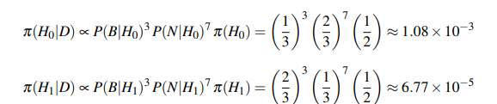
Posterior
Now we can compute the posterior

Slide 17
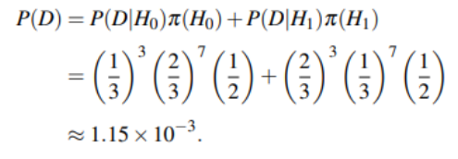
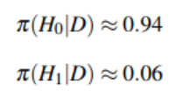
Total probability [notebook]
The only thing we need is the denominator so that it sums to 1.
By the Law of Total Probability
then:

Slide 18
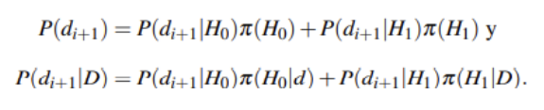
Predictive
What we actually want is not the probability of the urns, but of the colors.
By total probability

Slide 19
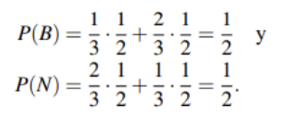
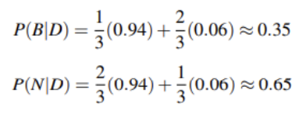
Predictive [notebook]
We can get the prior predictive
And the posterior as well

Slide 20
Going continuous

Slide 21
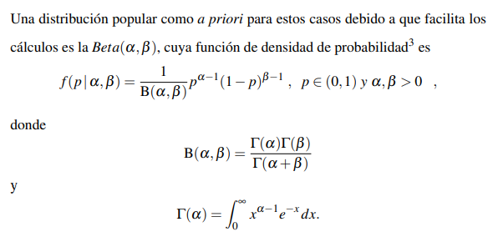
Going continuous

Slide 22
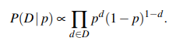

Likelihood [notebook]
The likelihood remains, since the data are binary:
With the above, the prior

Slide 23
Generative model Beta-Binomial
p~Beta(1,1)
color~Bernoulli(p)
Colors

Slide 24



Likelihood of the data
Recalling the above
We can write the likelihood as a function of the data as

Slide 25

Obtaining the posterior [notebook]
Using Bayes
Simplifying

Slide 26
Conjugate models

Slide 27
Definition
A conjugate model is a pair of parametric families Prior–Likelihood such that, when updating with data, the posterior belongs to the same parametric family as the prior
Example:
Beta-Binomial -&gt; Beta posterior

Slide 28
Bayes Factor

Slide 29
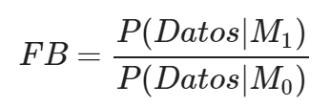
Definition
The Bayes factor is given by
It represents the ratio between the evidence under the alternative hypothesis vs the null

Slide 30
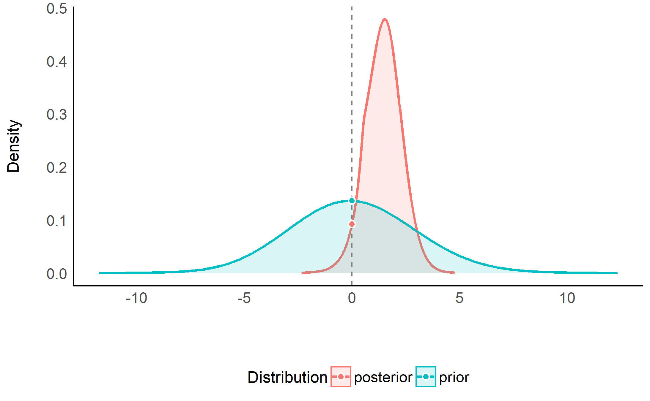
Approximation of the Bayes Factor
We can approximate it with the "null" value under the prior (centered on the null value) vs the "null" value under the posterior

